Slide 1

Data structures using C
Module 3 - Lecture VII
Circular Link Lists
Prepared By
Ms. Smriti Sehgal

Slide 2
What is circular linked list?
Circular linked list is a variation of linked list in which the first elements points to the next element and the last element points to the first element.
Both singly and doubly linked list can be made into a circular linked list.
Circular linked list can be used to help traverse the same list again and again if needed.

Slide 3
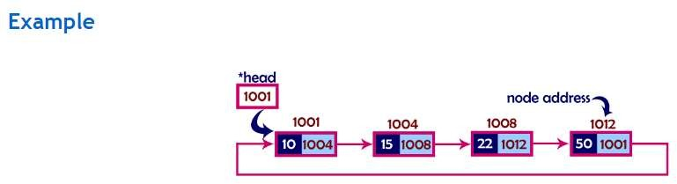
Fun fact:
If you are worried about its implementation, then stop doing that because instead of placing NULL at the last node’s address field you are placing the address of very first node!

Slide 4
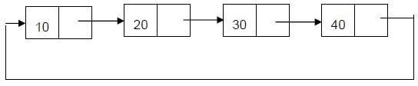
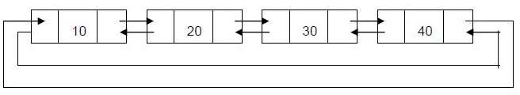
Types of circular linked list:
1. Singly: The last node points to the first node and there is only
link between the nodes of linked list.
2. Doubly: The last node points to the first node and there are two links between the nodes of linked list.

Slide 5
Advantages of Circular linked lists:
Any node can be a starting point. We can traverse the whole list by starting from any point. We just need to stop when the first visited node is visited again.
Circular lists are useful in applications to repeatedly go around the list.
Disadvantages of Circular linked lists:
Depending on the implementation, inserting at end of list would require doing a search for last node which could be expensive.
Finding end of the list and loop control is harder ( no NULL’s to mark the beginning and end).

Slide 6
Operations on singly circular linked list
Insertion
Deletion
Display

Slide 7
Insertion :
Insertion can be of three types.
▫ Insert at first
▫ Insert at last
▫ Insert after constant
Note: insertion after constant in circular and linear linked list is exact same .

Slide 8
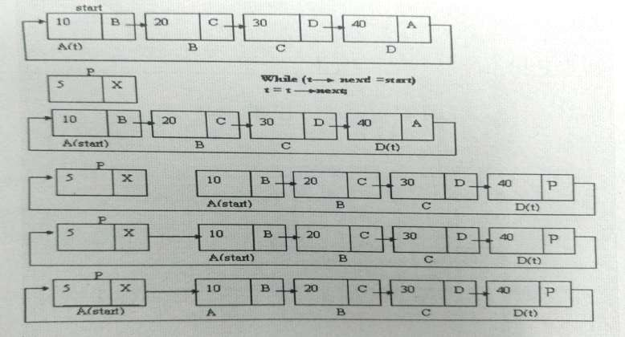
Insertion at first

Slide 9
Algorithm
1 - Create a newNode with given value.
2 - if ( START == NULL)
set START = newNode
newNode→next = START
4 - else
set temp = START
5 - Repeat the step (while 'temp → next is not equal to START).
temp = temp → next
6 - Set 'newNode → next =START
Set START = newNode
temp → next = START .

Slide 10
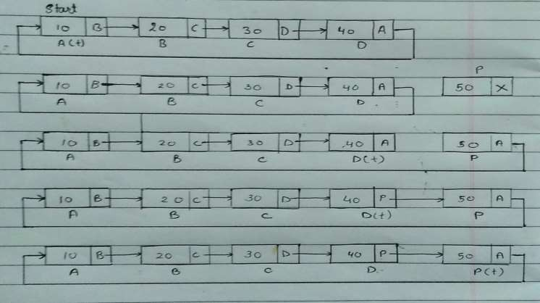
Insert at last

Slide 11
Algorithm for insertion at last
1 Create a newNode with given value.
2 if (START == NULL).
set START = newNode
newNode → next = START.
3 else
set temp = START.
4 Repeat step (while temp → next is not equal to START).
temp = temp → next
5 Set temp → next = newNode
6 newNode → next = START.

Slide 12
Algorithm for insertion at POS position other than start and end
Input ITEM and POS to be inserted
set temp = START and K=1
Repeat the step 3 while( k is less than POS-1)
(a) TEMP = TEMP → Next
(b) If (TEMP is equal to START)
(i) Display “Number of Node in the list less than the position”
(ii) Exit
(c) k = k + 1
4. Create a New Node
5. NewNode → DATA = ITEM
6. NewNode → Next = TEMP → Next
7. TEMP → Next = NewNode
8. Exit

Slide 13


